Slide 1

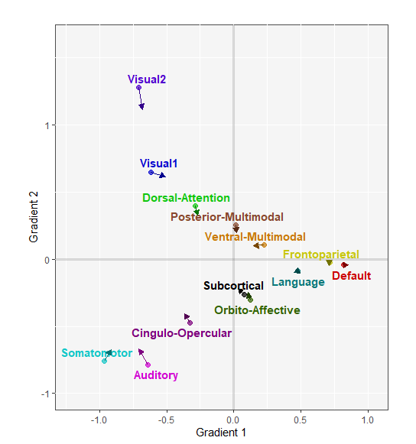
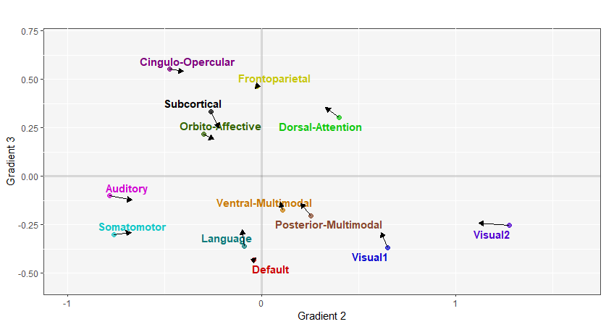
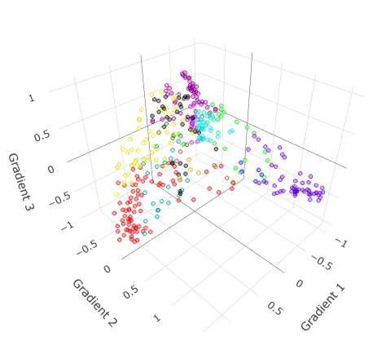
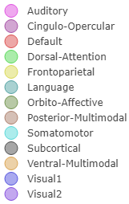
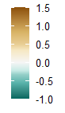
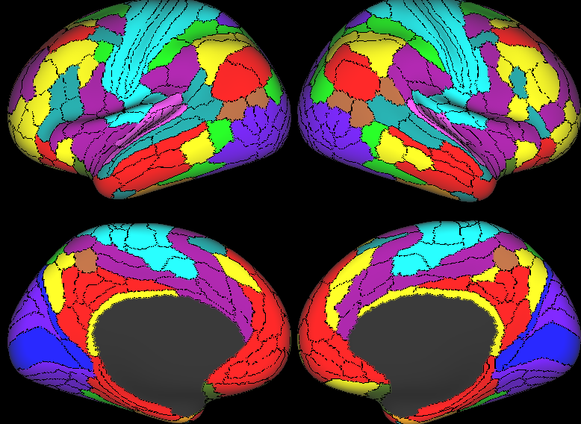
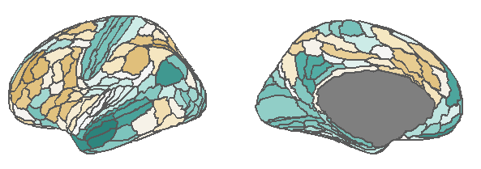
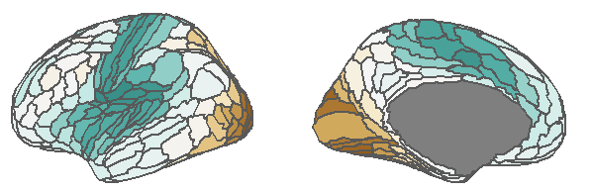
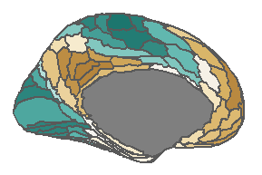
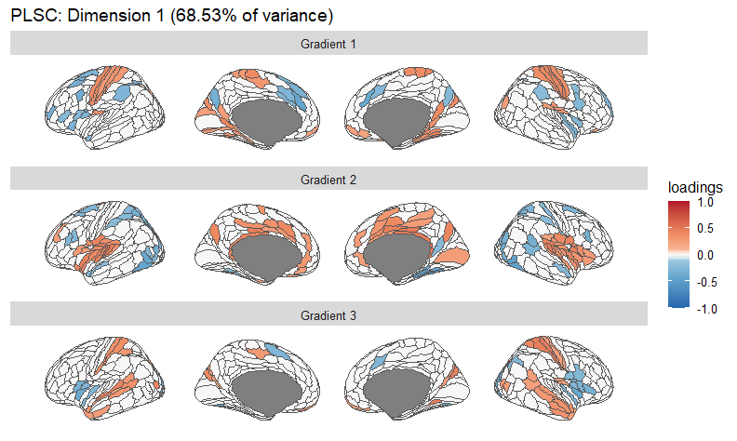
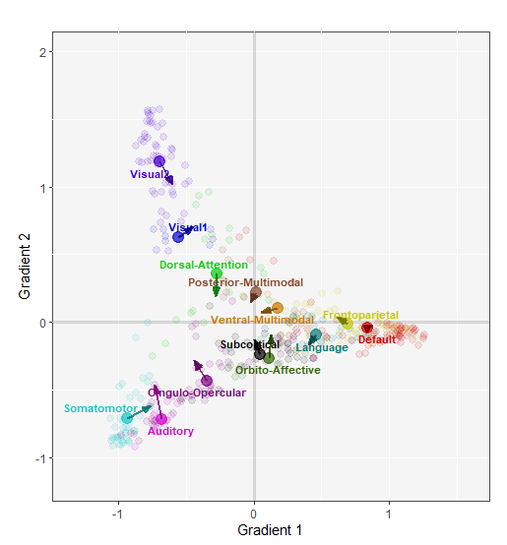
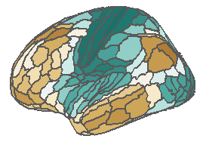
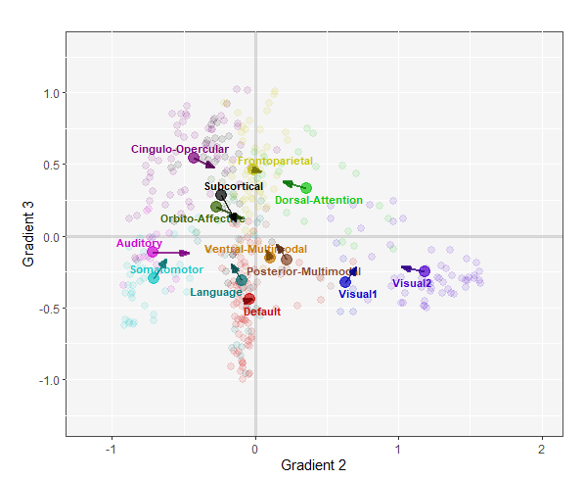
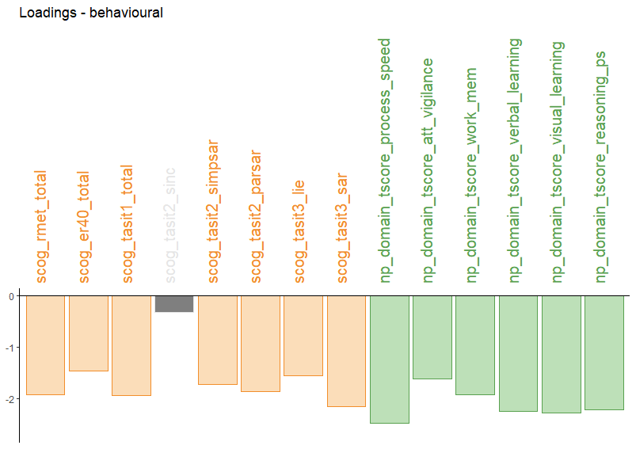
Using multivariate partial least square correlation to examine the association between brain network stratification and social cognitive measures in schizophrenia spectrum disorders (SSD)
Dysconnectivity in “lower order” and “higher order” cortical networks of SSD
Dysconnectivity can be characterized by connectivity gradients (Margulies et al., 2016)
Background
Control-SSD shift in Gradients
Cortical Networks in “gradient space”
Decrease network differentiation in SSD
Decompose correlation between gradients and behavioral measures
Multivariate method: partial least square correlation (PLS-C)
(Glasser et al., 2016)
Resting-state fMRI from “Social Processes Initiative in Neurobiology of the Schizophrenia(s) (SPINS)” study
Social cognition and neuropsychological measures
Method
 | SSD (N = 248) | Controls (N = 172)
Age | 31.42 (9.77) | 31.95 (10.40)
Gender | 79 Females (31.85%) | 80 Females (46.51%)
Decrease network differentiation is associated with impaired cognitive abilities from control to SSD
Notes:
SSD has been associated with dysconnectivity in “lower order” (visual, auditory) and “higher order” cortical networks (DMN, FPN)
We can characterize such dysconnectivity by extracting connectivity gradients with diffusion map embedding
In this study, we analyzed data from a multi-site study called the social processes initiative in neurobiology of schizophrenias (SPINS)
From SPINS, we extracted connectivity gradients from the resting state data of healthy controls and patients with SSD and we also measured their social and neuropsychological measures.
The gradient result showed a decreased differentiation of networks in SSD compared to controls.
The results from a multivariate analysis using partial least square correlation found the association between impaired social cognitive abilities and decreased differentiation between visual and auditory networks, and between language and subcortical networks

